Slide 1


Data Structures
#LifeKoKaroLift

Slide 2



Module Name - Stacks & Queues
Class - Day 7
Topic Name: Problems on stack
EditEdit MasterMaster texttext stylesstyles

Slide 3
Time Allocation Summary
Element | Slide numbers | Maximum time(min)
Spot Test | 4
Today’s Agenda | 5
Duplicate Parentheses Problem | 6 - 9
Reverse A stack | 10 - 13
Finding K^{th} Largest Element | 14 - 15
Key takeaways | 16
Total Time |  | 120

Slide 4
Spot Test
How do we implement stack data structure using two queues.
How do we implement stack data structure using only one queue.

Slide 5

Today’s Agenda
Duplicate Parentheses Problem
Reversing a Stack
Finding Kth Largest Element Problem

Slide 6
Duplicate Parentheses Problem
You all remember the “Matching Parentheses” problem from Stacks. Don’t you?
Well here’s another problem statement involving those parentheses again.
For any programming language structure or for any algebraic expression, it is mandatory to have all parenthesis “( )” balanced.
However, there may be instances where these parentheses are duplicated.For example: (((1*2))+5)
Let’s see the approach now:

Slide 7
Duplicate Parentheses Problem
If you had to solve this problem manually, wou will definitely start by resolving the innermost parentheses. Our algorithm works on the same principle.
We start by declaring a stack and iterating through the complete length of string and pushing the elements inside the stack until we encounter the first closing parentheses “)”.

Slide 8
Duplicate Parentheses Problem
Now we start popping the elements till we encounter the first “(”.
If the count of number of elements popped is 1 or 0, we say that string contains duplicate parentheses.
Otherwise, after full string traversal, we say that it does not contains duplicate parentheses.

Slide 9
Duplicate Parentheses Problem
Let’s see the java code:
Stack<Character> stack = new Stack();
for (int i = 0; i < inputString.length(); i++) {
char ch = inputString.charAt(i);
if (ch != ')') {
stack.push(ch);
}else{
char top = stack.peek();
stack.pop();
int count = 0;
while (top != '(') {
top = stack.peek();
stack.pop();
count++; }
if (count <= 1) { return "true"; }}}
return "false";

Slide 10
Reverse A Stack
In the coming few slides, we will be shortly discussing a few problem statements on stacks and queues, which will be followed by the approach to solve the question. These questions are:
Reverse a stack
Find K^{th} largest element
Identify a palindromic string

Slide 11
Reverse A Stack
Let’s start with the first one, Reversing a stack.
One of the applications of a stack is to reverse an input sequence. To reverse a sequence, you can insert the characters of that sequence one by one and later pop them out to get the reversed output.
But what if we want the input sequence to be reversed within the stack itself?
For example: If the input stack contains elements { a b c d e } where 'e' is the element at the top of the stack then reverse stack would contain elements { e d c b a } where 'a' is the element at the top of the stack.

Slide 12
Reverse A Stack
Let’s approach this problem with the pseudocode given below which uses two functions in its implementation:
//Pseudocode to reverse the stack
function reverse()
A. IF stack is not empty
//Hold all items in function call stack until we reach the end of the stack
1. LET i contains top element from stack.
2. POP the top element from stack.
3. reverse()
// Insert all the items in function call stack one by one from the bottom to top. Each item is inserted at the bottom of the stack
4. insertAtEnd(i)

Slide 13
Reverse A Stack
// This function inserts an element at the bottom of a stack
function insertAtEnd(i)
A. IF stack is empty
1. PUSH i to the top of the stack
B. ELSE
/* All items are held in function call stack until we reach end of the stack.When the stack becomes empty the item is inserted at the bottom.*/
1. In variable j we will store the value which is at the top of stack.
2. POP the top element from the stack
3. insertAtEnd(i)
//Push all the items which are held in function call stack once the item is inserted at the bottom
4. PUSH j to the top of the stack

Slide 14
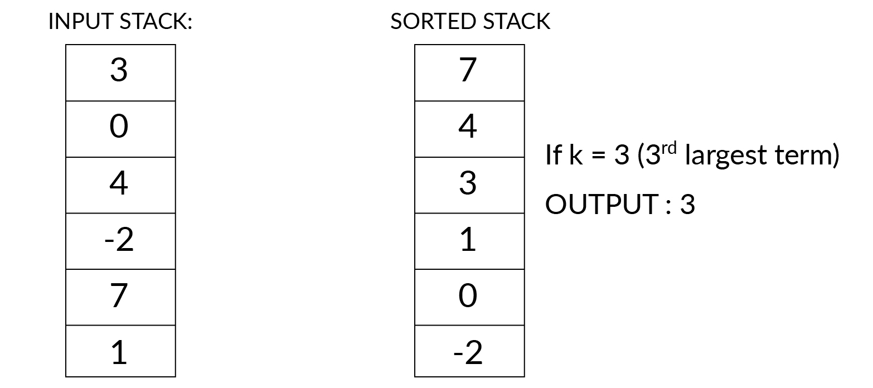
Finding K^{th} Largest Element
The next problem is about finding the k^{th} largest element given a set of elements.
To find the kth largest element, you will have to somehow compare every element with every other element. Here, the task is to first sort and then find the kth largest element in the given input sequence.
Consider the example on the right. It clarifies further the need to sort the stack for our solution

Slide 15
Finding K^{th} Largest Element
Here’s the approach to solve our problem( sort the stack):
Create a new stack and name it temp.
While the input stack is NOT empty.
pop() the top value from input stack and store it in temporary integer variable ‘value’.
While ‘temp’ stack is NOT empty AND ‘value’<top value in ‘temp’ stack
Pop the top value from the ‘temp’ stack and push it to ‘input’ stack.
c. Push the ‘value’ to the ‘temp’ stack.
3. Return ‘temp’ stack, which contains all the elements in the input stack in descending sorted order.

Slide 16
Key Takeaways
It’s time to answer the key takeaways from this lesson.
Follow the path to answer:
Module:- Stack & Queues
Session:- Queues
Segment:- Summary
OR
Follow the link:
<https://learn.upgrad.com/v/course/439/session/39891/segment/214112>

Slide 17
Thank You!
P.S. - Don’t forget the home assignment for today.
<https://learn.upgrad.com/v/course/439/session/39891/segment/214114>
Happy learning!
#LifeKoKaroLift

